Slide 1

Welcome To Presentation
I’m ______, and I’ll be sharing you my Insights, analysis and recommendations on a staff stress dataset.
Date
24-02-2025

Slide 2
MAIN OBJECTIVES
Identifying Major Stress Sources.
Exploring the impact of sleep quality and heart rate on stress levels.
Understanding how doctors cope with stress.
Highlighting the highest peak stress periods.

Slide 3
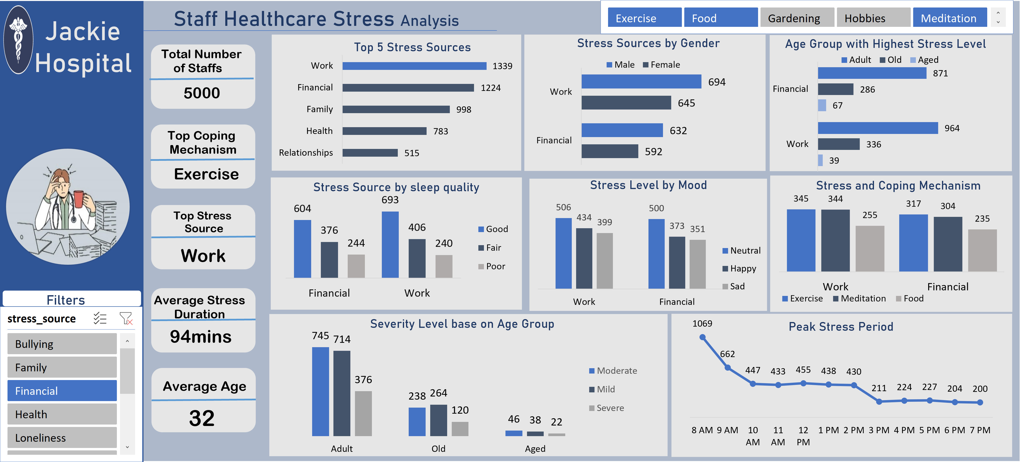
Dashboard Preview

Slide 4
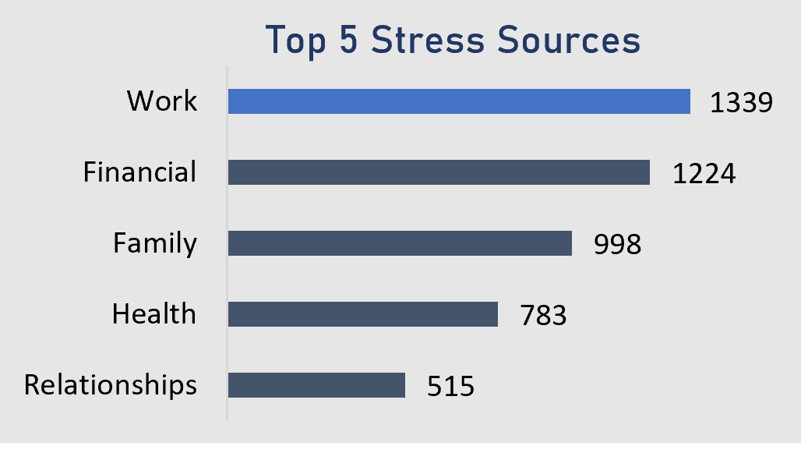
The Stress Source Frequency
The 5 Top Stress Source chart provides insights into primary factors contributing to stress among individuals. The analysis reveals that:
Work related stress is the most significant factor, indicating that a majority of individuals experience stress due to job related pressures, deadlines or workload.
Financial is the second highest stress source, suggesting that economic concerns, such as debt or insufficient income, play a major role in stress levels.
Family and health related stress also contributes significantly, showing that personal relationships and medical conditions impact stress level.

Slide 5
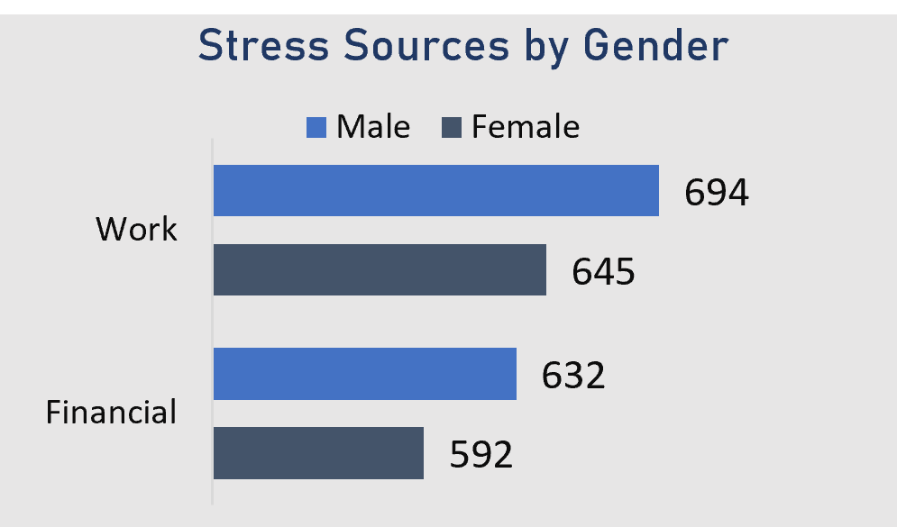
The Stress Source by Gender
The top 2 Stress Source by Gender chart provides insights into how different stress factors affect males and females. The analysis reveals that:
Work related stress is high for both gender, but slightly higher among males, indicating that job related pressures are major concern especially for men.
Financial Issues is also high for both genders, with males experiencing a slightly higher level of financial issues than females.

Slide 6
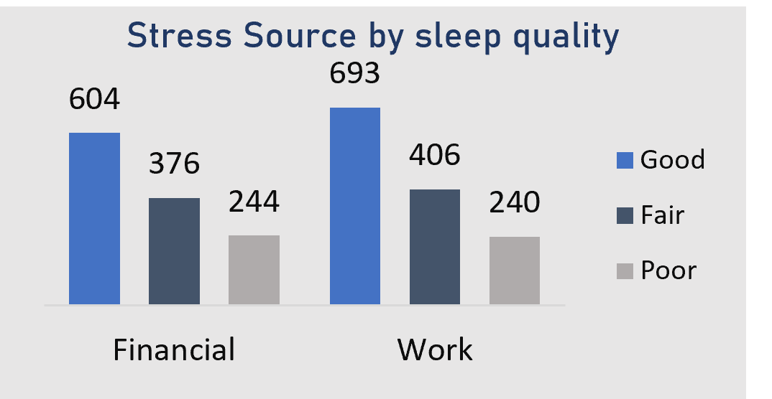
Factors Contributing to increased stress levels: Stress Source by Sleep Quality
The Stress Source by Sleep Quality chart examines the relationship between different stress factors and sleep patterns. The analysis reveals:
Work related stress is one of the most common cause among those with poor sleep, possibly due to extended work hours, deadlines or job related anxiety.
Financial stress is also a significant factor, as people with financial difficulties may experience sleep disturbances due to worry and anxiety.
Unexpected stress distribution:
Based on logical expectations, staffs with “Poor” sleep quality were anticipated to report the highest stress levels. However the chart shows that staffs with “good” sleep had the highest stress.
Possible causes of the issue:
Data collection Bias: The dataset might have fewer individuals with poor sleep, affecting the representation.
Some respondents may have been misclassified under “Good” or “Fair” sleep quality.

Slide 7
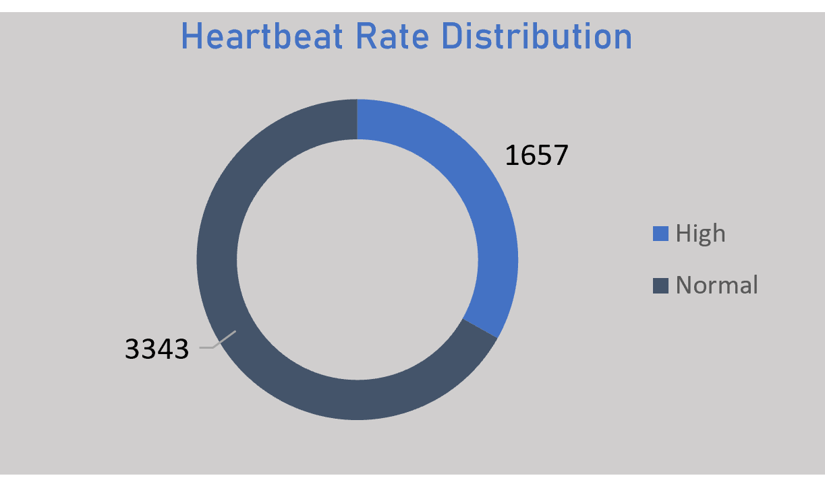
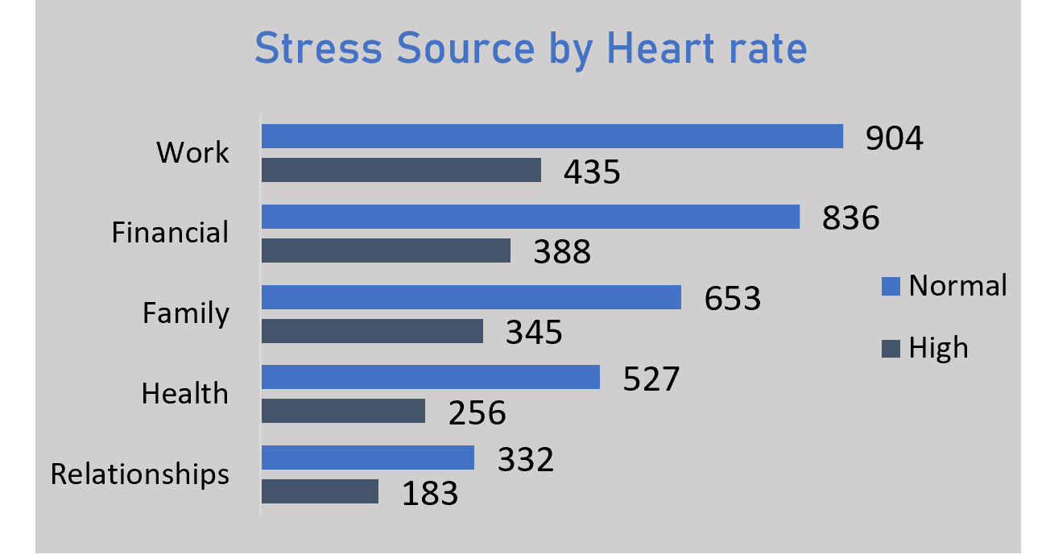
Impact of Stress on Heartbeat Rate and its sources.
The donut represents the heartbeat rate distribution, categorizing individuals into two groups based on their heartbeat rate.
This distribution helps us understand how many individuals experience an elevated heartbeat rate, which may indicate stress.
The bar chart breaks down the sources of stress and their impact on heartbeat rates.
It categorizes stress sources (work, financial, family, health and relationships) and shows how many individuals in each category have either a normal or high heartbeat rate.

Slide 8
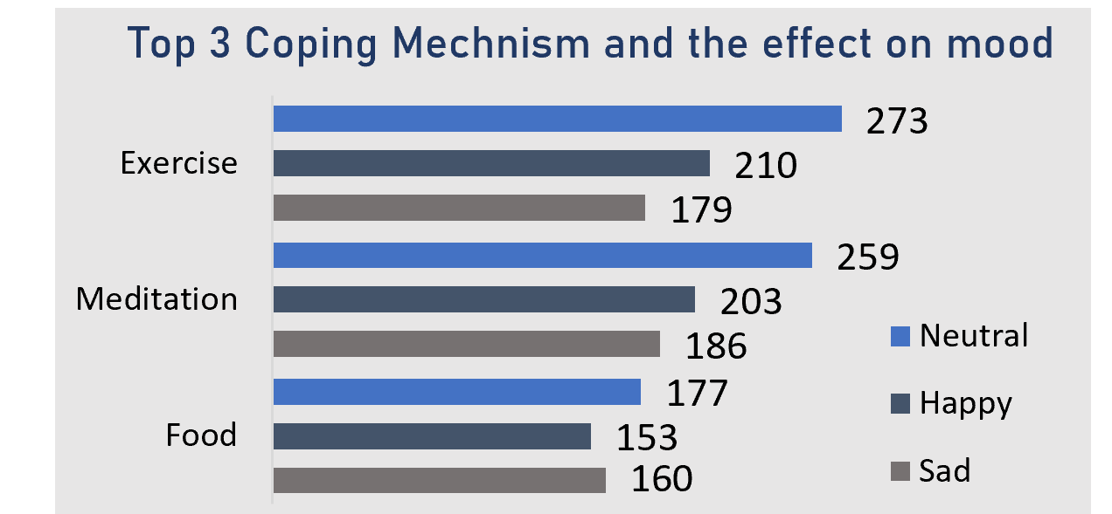
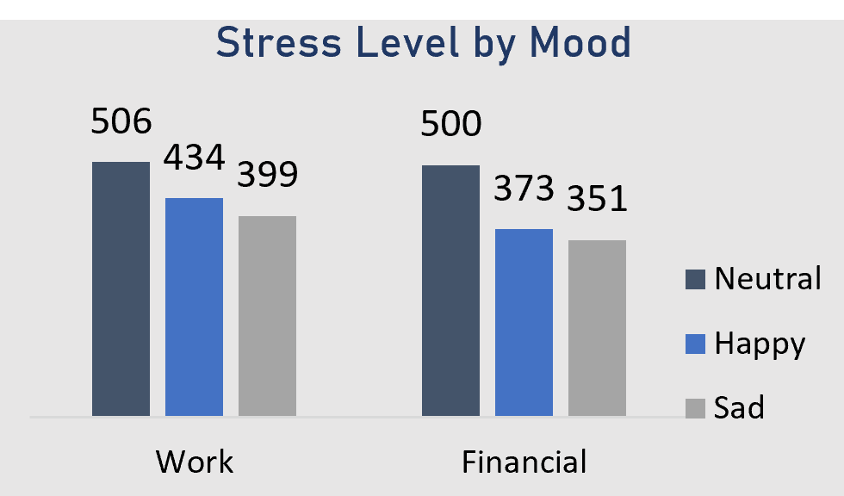
Stress Level by Mood
The Stress level by Mood chart provides insights into how stress affects staffs’ emotional well-being. The analysis reveals the following:
Work and financial stress are the leading causes of emotional distress contributing significantly to increased sadness.
Staffs who are happy tend to have lower stress levels, indicating that effective coping mechanisms as shown in F2, contributes to emotional well being
F2

Slide 9
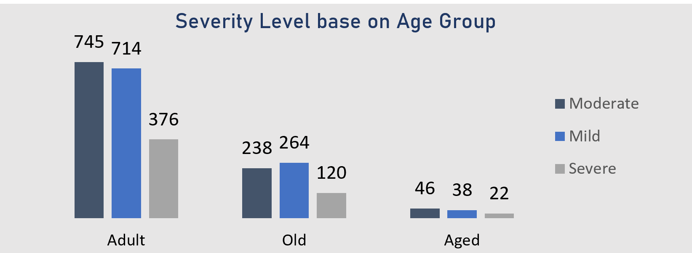
Severity Level base on Age Group
This chart illustrates the severity levels of stress across different age groups: Adult, Old and Aged.
Adults (below 35) experienced the highest level of stress severity, with a significant number categorized under moderate and mild stress. This suggests that working age individuals face most stress, likely due to personal responsibilities.
Old (36-59) individuals have lower stress severity compared to adults but still experience moderate and mild stress at a considerable rate. This may indicate stress from health concerns, financial stability or family responsibilities.
Aged (60 and above) individuals experience the least amount of stress across all severity levels. This could be attributed to retirement, fewer work related pressures and possibly more stability in their lifestyle.

Slide 10
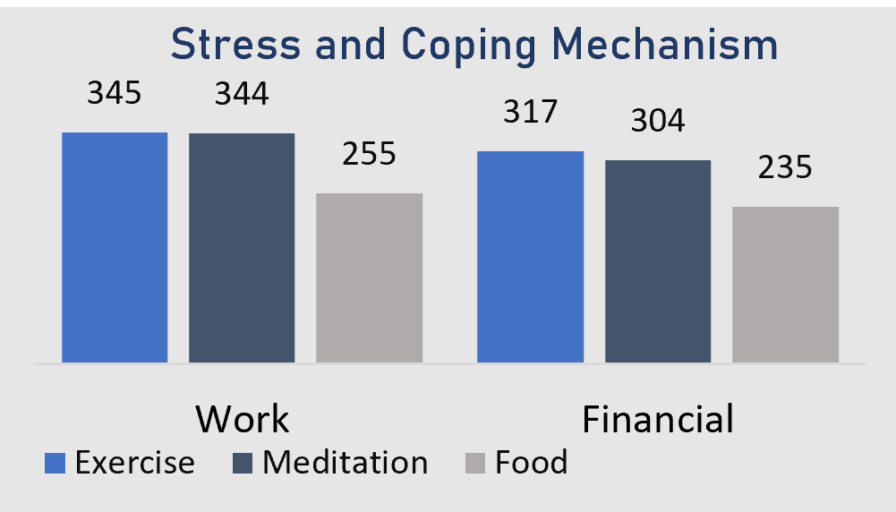
Stress and Coping Mechanism
The stress and coping mechanism chart analyzes how different coping strategies impact stress levels among Staffs. This data suggests the following:
Exercise is the most effective coping mechanism, particularly for those experiencing work related and financial stress.
Other methods such as meditation, food, therapy and hobbies also contribute to stress reduction.

Slide 11
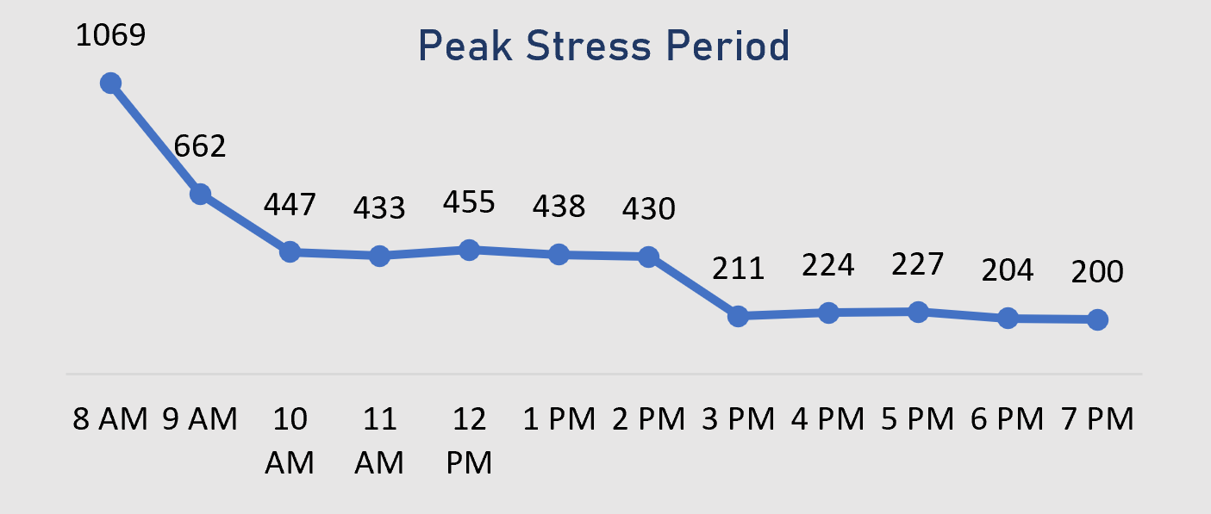
Peak Stress Period
This chart displays the Peak Stress Period across different hours of the day, showing when stress levels are at their highest.
The highest peak occurs at 8am with 1069 recorded stress cases, indicating that mornings are the most stressful time. This is likely due to the start of the workday, morning rush and workload anticipation.
From 10am to 2pm, stress levels fluctuate but remain relatively stable, suggesting a steady workload pressure during these hours.
By 3pm onward, stress levels drop more sharply, reaching the lowest point between 6pm and 7pm (204 – 200 cases), indicating that as the workday ends, stress levels reduce.

Slide 12
Final conclusion and recommendation
Addressing work-related and financial stress – Implement policies that promote work-life balance, financial wellness programs, and counseling services for staffs.
Improving sleep quality – Encourage structured rest periods, better shift planning, and stress management programs to ensure doctors get sufficient rest.
Promoting effective coping mechanisms – Exercise is identified as a powerful tool for reducing stress, and hospitals should implement wellness programs that include physical activities.
Reducing morning stress peaks – Since 8 AM is the most stressful period, hospitals should explore workload redistribution strategies to ease pressure during early hours.

Slide 13
Understanding employee stress patterns is crucial for fostering a healthier and more productive workplace.
Thank you for your time.

